Slide 1
Efficiency
Quantifying and comparing the efficiencies of the decision making units

Slide 2
Productive efficiency (Production efficiency)
Economics teaches us effective utilization of resources for the maximization of benefits (output).
Productive efficiency is an aspect of economic efficiency focusing on maximizing the output under given constraints (without worrying about optimal allocation, or choice of products, etc.).
The productive efficiency “frontier” are all the combinations of outputs such that the production of one product cannot be increased without sacrificing the output of the other (without any change in the technology).
If the organization (any economic unit) is not on the frontier, it is inefficient.

Slide 3
Efficiency measurement
In the simplest way, efficiency is defined as the ratio of the output to the input.
However, in reality, this is complex. Why?
Input
Output

Slide 4
Efficiency measurement
Multiple types of inputs: Labor (white collar, blue collar, etc.); Infrastructure (factory, buildings, land, machinery, etc.); Money (financial assets, loan, etc.)
Essentially, resources goes as inputs.
Output can also be in many shapes and forms: customers served/acquired; profits; sales volume, etc.
How has the organization (or the economic unit) performed is the output.

Slide 5
Immediate questions
How does the ratio of input to output work in presence of several inputs and several outputs?
How do we, then, calculate the productive efficiency of an economic unit?
More importantly, how do we compare several economic units on their efficiency?
If an economic unit turns out to be inefficient, how can they become efficient?

Slide 6
Common approaches
Operating ratios: Labor cost per transaction; sales per square feet; runs per innings.
Problem: Doesn’t reflect varying mix of inputs and outputs found in more diverse operations.
Financial ratios: Price to earnings ratio (PE); Debt to equity ratio; Earnings per share (EPS).
Problems?
Some inputs/outputs cannot be valued in currency terms.
Profitability is not the same as operating efficiency.

Slide 7
Graphical method
Efficiency comparison

Slide 8
When things are simpler…
When we only have a single input and a single output, a simple ratio of the input to the output is the efficiency.
The economic unit with the highest ratio is the most efficient.
Other economic units need to either increase the output for the same level of input; or reduce the input to achieve the same level of output.
See the data and the graph……

Slide 9
Single input, single output
Sales office | Budget (INR) | Sales (INR) | Sales per INR invested
1 | 3,00,000 | 11,10,000 | 3.7
2 | 2,56,000 | 17,50,000 | 6.8
3 | 5,00,000 | 34,50,000 | 6.9
4 | 3,90,000 | 12,24,000 | 3.1
5 | 1,85,000 | 24,00,000 | 13.0

Slide 10
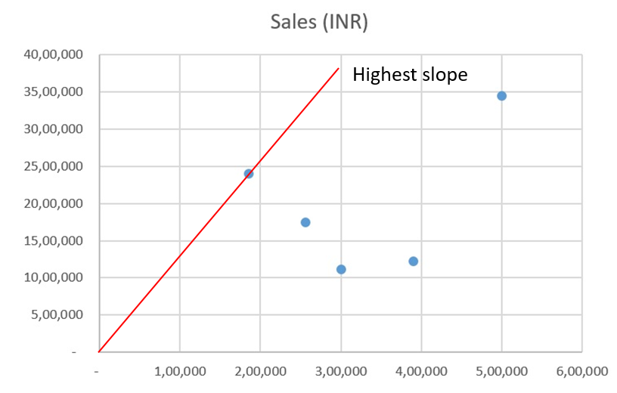
Single input, single output

Slide 11
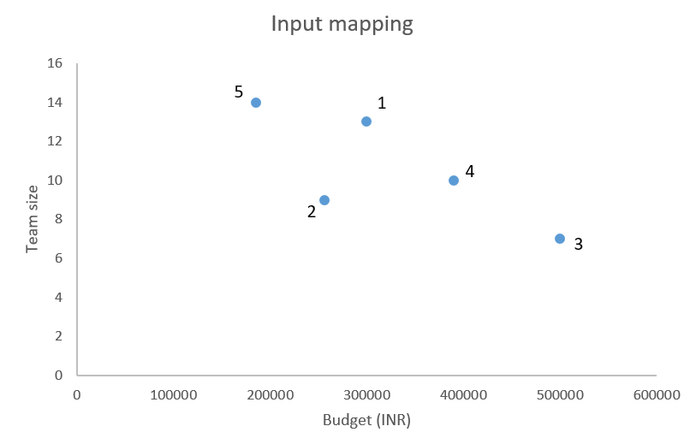
More inputs/outputs
For two inputs and an output too, things are not difficult.
Assume that each of the sales office has the same sales target: INR 10,00,000 (output). They have their budgets approved and the respective team sizes (inputs).
Sales office | Budget (INR) | Team size
1 | 3,00,000 | 13
2 | 2,56,000 | 9
3 | 5,00,000 | 7
4 | 3,90,000 | 10
5 | 1,85,000 | 14

Slide 12
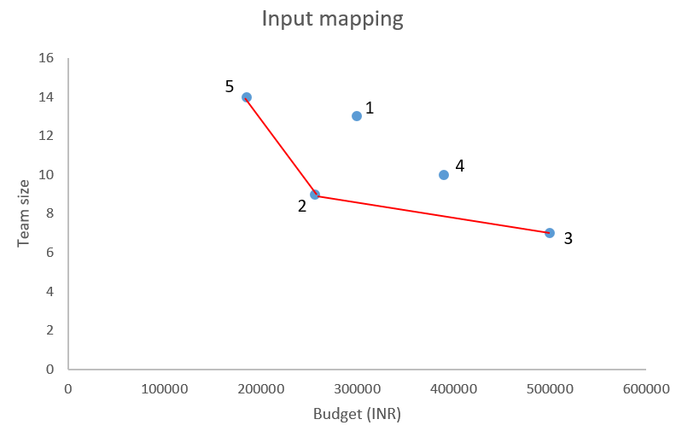
Two inputs, single output: Efficiency frontier
Sales office | Budget (INR) | Team size
1 | 3,00,000 | 13
2 | 2,56,000 | 9
3 | 5,00,000 | 7
4 | 3,90,000 | 10
5 | 1,85,000 | 14

Slide 13
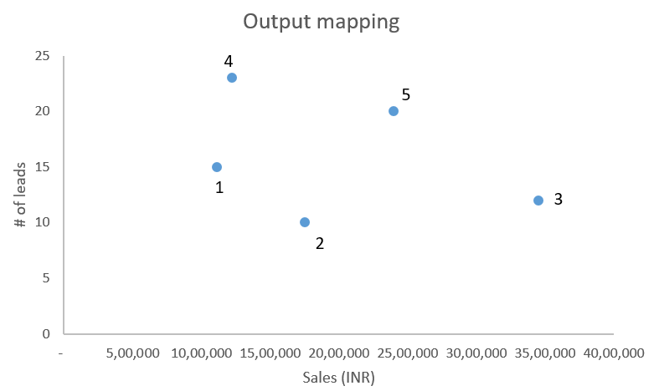
One input, two outputs
Let every sales office be given the same budget (INR 2,00,000). The sales achieved (in INR) and the potential sales leads (potential customers) are the outputs we track.
Sales office | Sales (INR) | No of leads
1 | 11,10,000 | 15
2 | 17,50,000 | 10
3 | 34,50,000 | 12
4 | 12,24,000 | 23
5 | 24,00,000 | 20

Slide 14
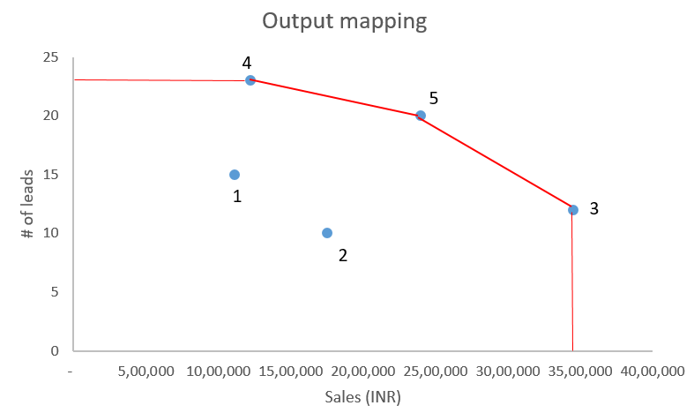
One input, two outputs: Efficiency Frontier

Slide 15
Optimization method
Data Envelopment Analysis

Slide 16
Data Envelopment Analysis (DEA)
A non-parametric mathematical method to find the production frontier.
Can be used to calculate the productive efficiency of an economic unit.
In the DEA terminology, an economic unit is referred to as a “Decision Making Unit (DMU)”.
What DEA measures is actually a relative efficiency – Calculate individual efficiencies for each DMU in a set of DMU’s.
Formulates an optimization problem for each DMU.

Slide 17
DEA logic
For multiple inputs and multiple outputs, define the weighted ratio.
Since various inputs can’t be directly added, define weights for each input. Similar approach for output.
But we don’t know the value of each weight?
Solution: Let each DMU choose the input and the output weights to its advantage.
Objective for each DMU: maximize its efficiency by choosing its weights carefully.
Constraints: Choose the weights such that using these weights, they shouldn’t get an efficiency more than 1!

Slide 18
DEA logic
Using a DMU’s weights, if it can’t achieve an efficiency of 1, then it is truly inefficient.
Using a DMU’s weight, if an other DMU gets an efficiency of 1, then that other DMU is really good!
Note that we are referring to only relative efficiency.

Slide 19
DEA – Mathematical formulation
K = # of DMU's considered in the dataset.
N = # of inputs considered for the DMU's
M = # of outputs considered for the DMU's.
I_{ik} = Recorded value of input i for the DMU k. (i = 1, 2, … N, k = 1, 2, …, K).
O_{jk} = Recorded value of output j for the DMU k. (j = 1, 2, … M, k = 1, 2, …, K).
x_{ik} = Weight assigned to input i by the DMU k. (i = 1, 2, … N, k = 1, 2, …, K).
y_{jk} = Weight assigned to output j by the DMU k. (j = 1, 2, … M, k = 1, 2, …, K).
E_{k} = Efficiency of the DMU k. (k = 1, 2, …, K)

Slide 20
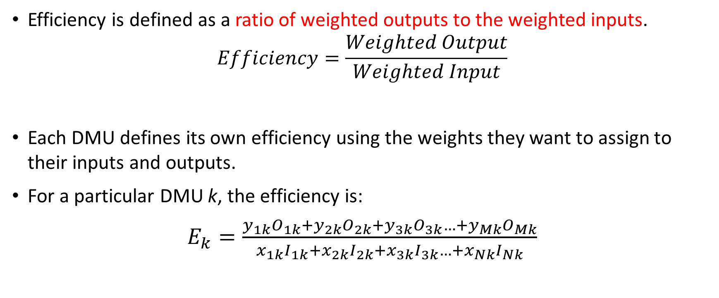
DEA – Mathematical formulation
Efficiency is defined as a ratio of weighted outputs to the weighted inputs.
$$Efficiency=\frac{Weighted Output}{Weighted Input}$$
Each DMU defines its own efficiency using the weights they want to assign to their inputs and outputs.
For a particular DMU k, the efficiency is:
$E_{k}=\frac{y_{1k}O_{1k}+y_{2k}O_{2k}+y_{3k}O_{3k}…+y_{Mk}O_{Mk}}{x_{1k}I_{1k}+x_{2k}I_{2k}+x_{3k}I_{3k}…+x_{Nk}I_{Nk}}$

Slide 21
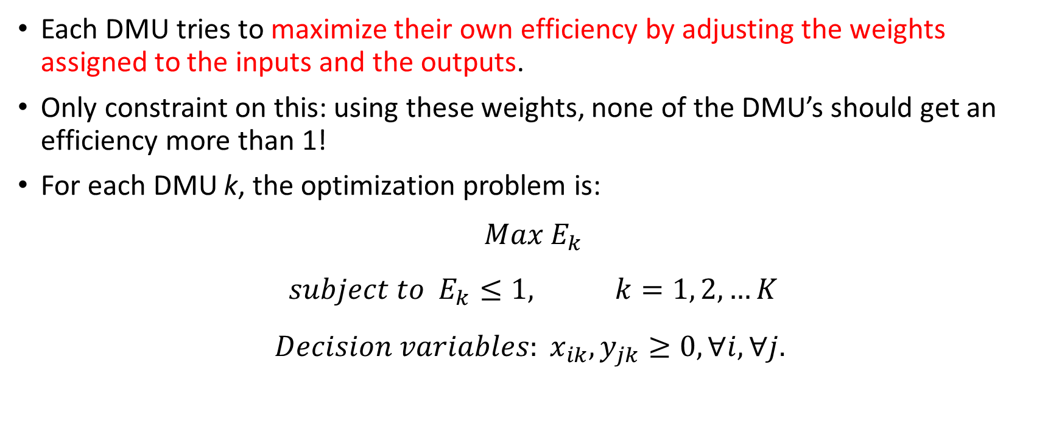
DEA – Optimization problem
Each DMU tries to maximize their own efficiency by adjusting the weights assigned to the inputs and the outputs.
Only constraint on this: using these weights, none of the DMU’s should get an efficiency more than 1!
For each DMU k, the optimization problem is:
$$Max E_{k}$$
$$subject to E_{k}≤1, k=1, 2, …K$$
$$Decision variables: x_{ik},y_{jk}≥0, ∀i, ∀j.$$

Slide 22
DEA – Optimization problem
Complexities
Remember that the efficiency was defined as a ratio of weighted inputs to weighted outputs.
Weights are the decision variables.
Hence the objective function and the constraints of this optimization problem are ratios of decision variables.
That is, they are NON LINEAR!
Is there a way to linearize the problem?
A linear optimization problem is much easier to solve, of course.

Slide 23
DEA – Optimization problem
To linearize, we maximize the numerator of the efficiency equation for the DMU k.
And normalize the denominator to 1.
For the constraints, we rearrange the efficiency terms to make it linear.
So the revised formulation is:

Slide 24
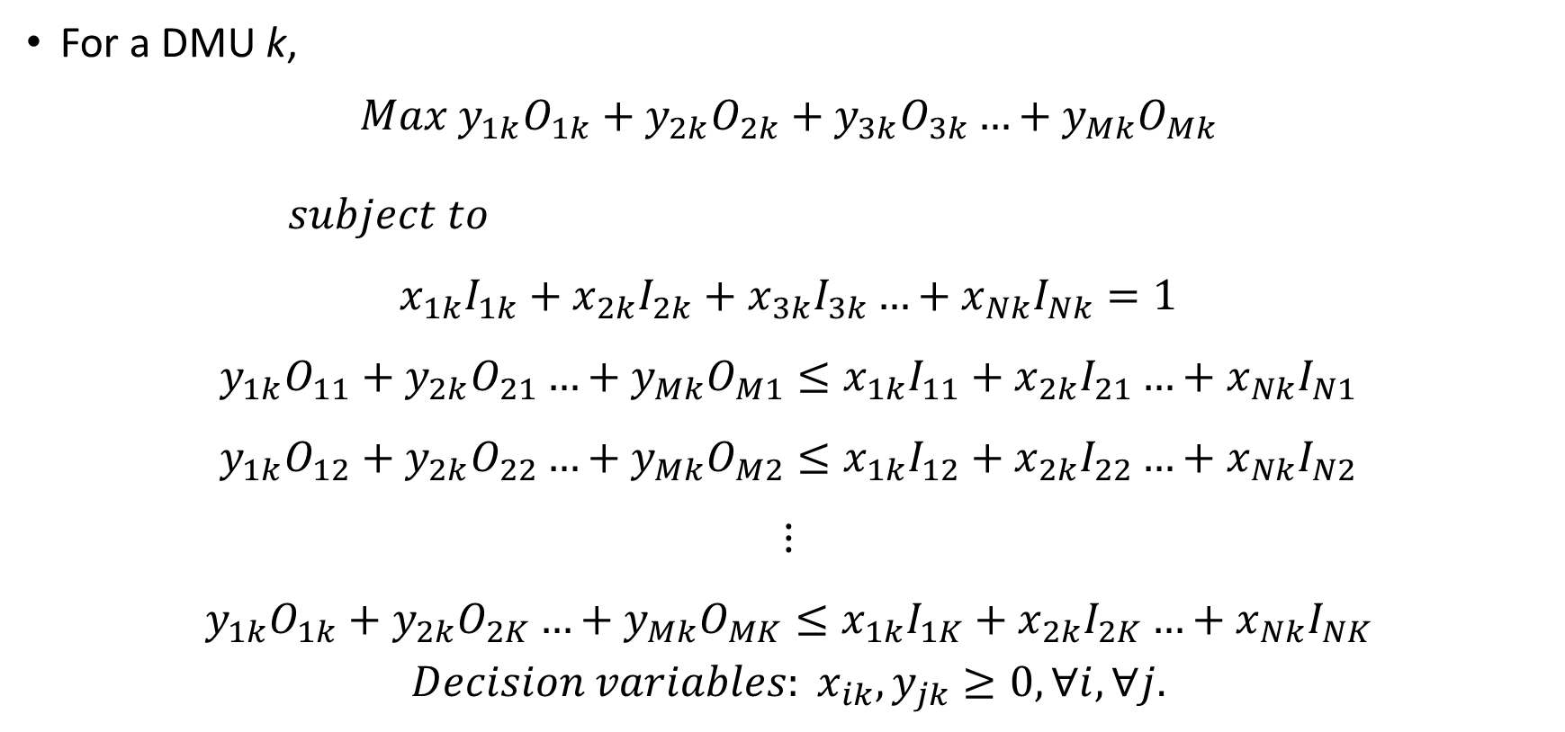
DEA – Optimization problem
For a DMU k,
$$Max y_{1k}O_{1k}+y_{2k}O_{2k}+y_{3k}O_{3k}…+y_{Mk}O_{Mk}$$
$subject to$
$$x_{1k}I_{1k}+x_{2k}I_{2k}+x_{3k}I_{3k}…+x_{Nk}I_{Nk}=1$$
$$y_{1k}O_{11}+y_{2k}O_{21}…+y_{Mk}O_{M1}≤x_{1k}I_{11}+x_{2k}I_{21}…+x_{Nk}I_{N1}$$
$$y_{1k}O_{12}+y_{2k}O_{22}…+y_{Mk}O_{M2}≤x_{1k}I_{12}+x_{2k}I_{22}…+x_{Nk}I_{N2}$$
$$⋮$$
$$y_{1k}O_{1k}+y_{2k}O_{2K}…+y_{Mk}O_{MK}≤x_{1k}I_{1K}+x_{2k}I_{2K}…+x_{Nk}I_{NK}$$
$$Decision variables: x_{ik},y_{jk}≥0, ∀i, ∀j.$$

Slide 25
DEA – LP
Example formulation and solution

Slide 26
DEA – Linear programming
Let us revisit the sales example where we had one output and two inputs.
Each sales office has the same sales target: INR 10,00,000 (output). They have their budgets approved and the respective team sizes (inputs).
Let us formulate linear programs to calculate the efficiency of each sales office.
Sales office | Budget (INR) | Team size
1 | 3,00,000 | 13
2 | 2,56,000 | 9
3 | 5,00,000 | 7
4 | 3,90,000 | 10
5 | 1,85,000 | 14

Slide 27
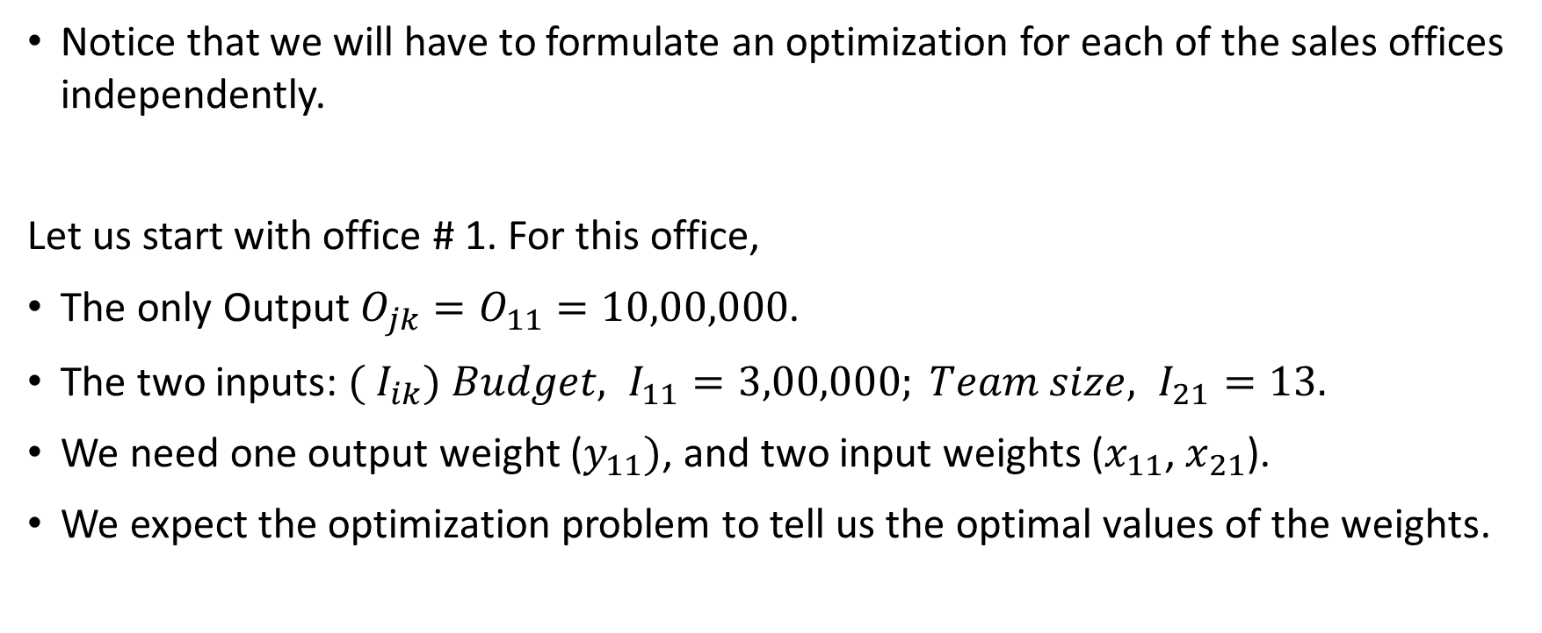
DEA – Linear programming
Notice that we will have to formulate an optimization for each of the sales offices independently.
Let us start with office # 1. For this office,
The only Output $O_{jk}=O_{11}=10,00,000$.
The two inputs: ${( I}_{ik}) Budget, I_{11}=3,00,000; Team size, I_{21}=13.$
We need one output weight ($y_{11})$, and two input weights ($x_{11}$, $x_{21}$).
We expect the optimization problem to tell us the optimal values of the weights.

Slide 28
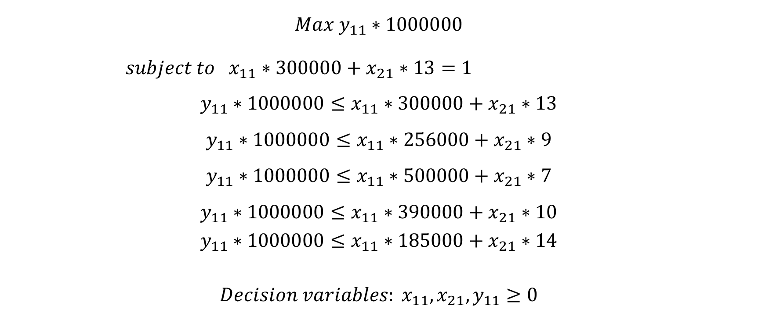
DEA – LP: Sales office 1
$$Max y_{11}∗1000000$$
$subject to x_{11}∗300000+x_{21}∗13=1$
$$y_{11}∗1000000≤x_{11}∗300000+x_{21}∗13$$
$$y_{11}∗1000000≤x_{11}∗256000+x_{21}∗9$$
$$y_{11}∗1000000≤x_{11}∗500000+x_{21}∗7$$
$$y_{11}∗1000000≤x_{11}∗390000+x_{21}∗10$$
$$y_{11}∗1000000≤x_{11}∗185000+x_{21}∗14$$
$$Decision variables: x_{11},x_{21},y_{11}≥0$$

Slide 29
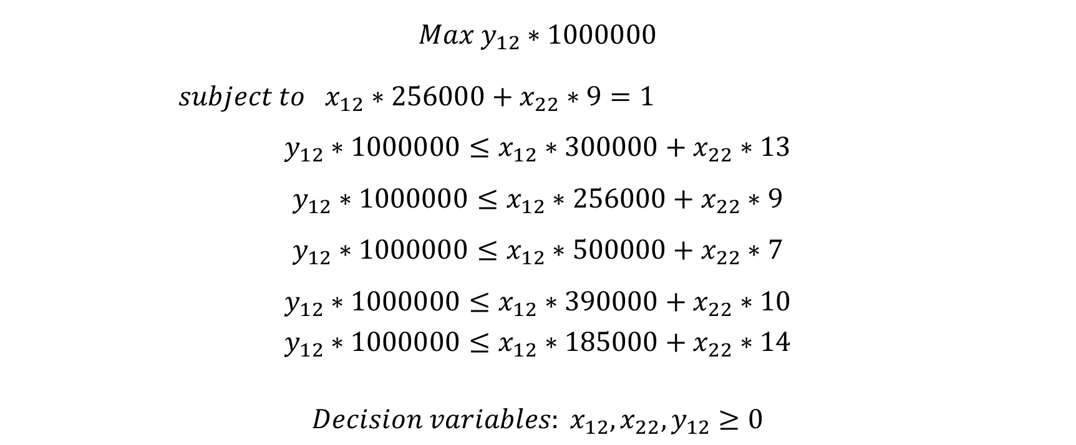
DEA – LP: Sales office 2
$$Max y_{12}∗1000000$$
$subject to x_{12}∗256000+x_{22}∗9=1$
$$y_{12}∗1000000≤x_{12}∗300000+x_{22}∗13$$
$$y_{12}∗1000000≤x_{12}∗256000+x_{22}∗9$$
$$y_{12}∗1000000≤x_{12}∗500000+x_{22}∗7$$
$$y_{12}∗1000000≤x_{12}∗390000+x_{22}∗10$$
$$y_{12}∗1000000≤x_{12}∗185000+x_{22}∗14$$
$$Decision variables: x_{12},x_{22},y_{12}≥0$$

Slide 30
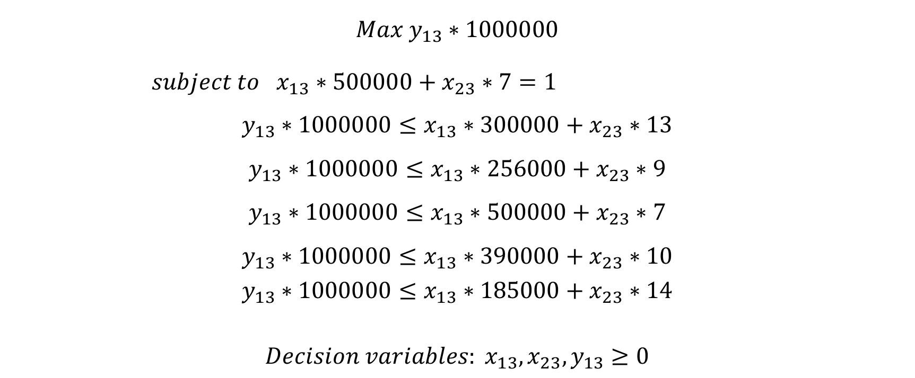
DEA – LP: Sales office 3
$$Max y_{13}∗1000000$$
$subject to x_{13}∗500000+x_{23}∗7=1$
$$y_{13}∗1000000≤x_{13}∗300000+x_{23}∗13$$
$$y_{13}∗1000000≤x_{13}∗256000+x_{23}∗9$$
$$y_{13}∗1000000≤x_{13}∗500000+x_{23}∗7$$
$$y_{13}∗1000000≤x_{13}∗390000+x_{23}∗10$$
$$y_{13}∗1000000≤x_{13}∗185000+x_{23}∗14$$
$$Decision variables: x_{13},x_{23},y_{13}≥0$$

Slide 31
DEA LP – Sales offices
Similarly, the LP can be formulated for the other offices.
See Excel sheet for the solution of the LP. Did we have the same solution in the graphical method?

Slide 32
DEA – LP: Two output case
Remember the sales problem where we had two output and a single input?
Every sales office be given the same budget (INR 2,00,000). The sales achieved (in INR) and the potential sales leads (potential customers) are the outputs.
Sales office | Sales (INR) | No of leads
1 | 11,10,000 | 15
2 | 17,50,000 | 10
3 | 34,50,000 | 12
4 | 12,24,000 | 23
5 | 24,00,000 | 20

Slide 33
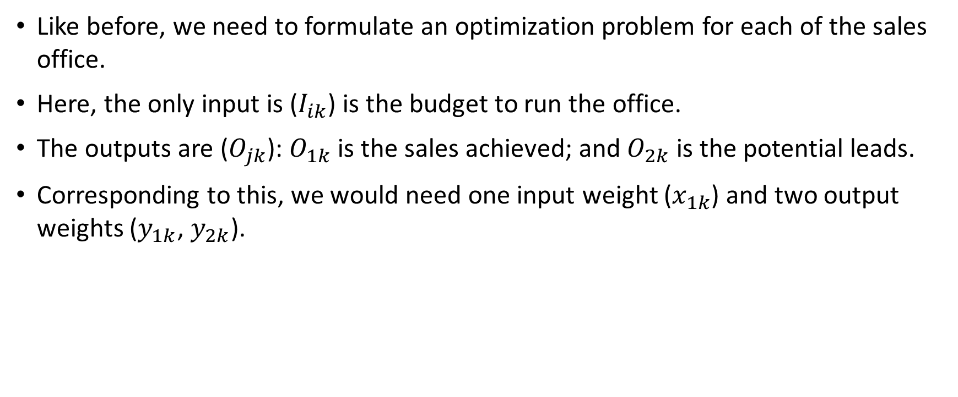
DEA – LP: Two output case
Like before, we need to formulate an optimization problem for each of the sales office.
Here, the only input is ($I_{ik}$) is the budget to run the office.
The outputs are ($O_{jk}$): $O_{1k}$ is the sales achieved; and $O_{2k}$ is the potential leads.
Corresponding to this, we would need one input weight ($x_{1k}$) and two output weights ($y_{1k}$, $y_{2k}$).

Slide 34
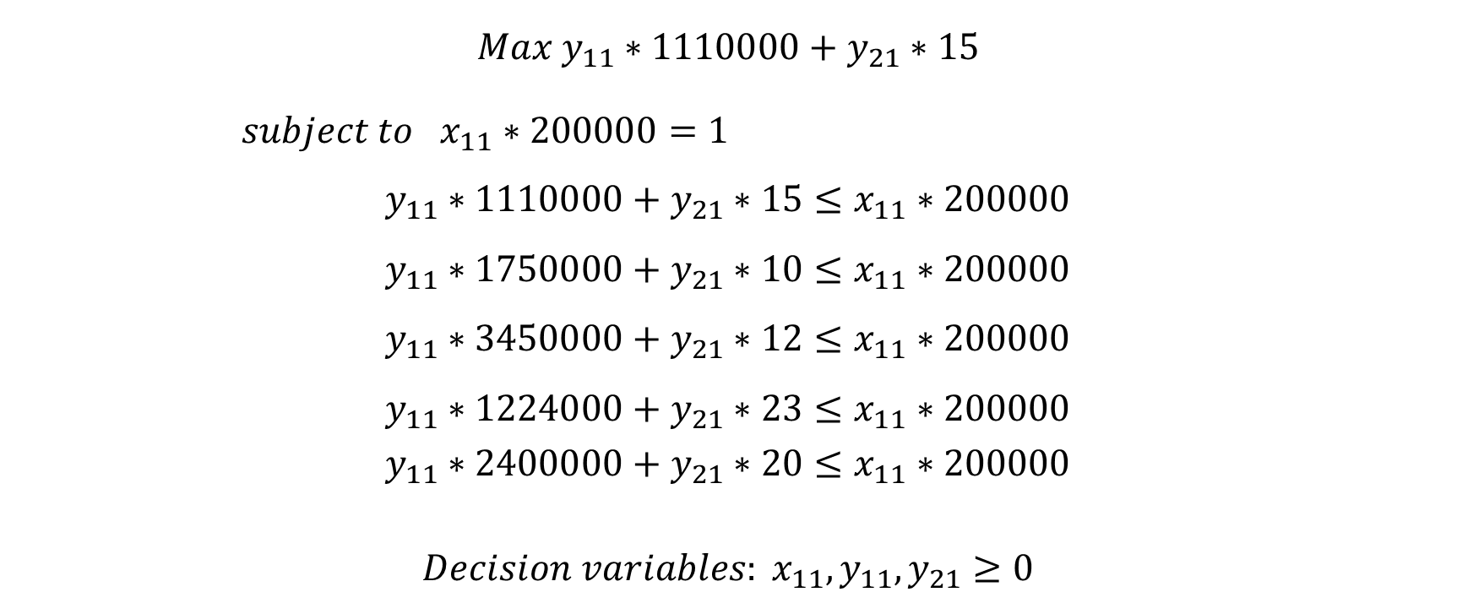
DEA – LP: Two output case – Sales office 1
$$Max y_{11}∗1110000+y_{21}∗15$$
$subject to x_{11}∗200000=1$
$$y_{11}∗1110000+y_{21}∗15≤x_{11}∗200000$$
$$y_{11}∗1750000+y_{21}∗10≤x_{11}∗200000$$
$$y_{11}∗3450000+y_{21}∗12≤x_{11}∗200000$$
$$y_{11}∗1224000+y_{21}∗23≤x_{11}∗200000$$
$$y_{11}∗2400000+y_{21}∗20≤x_{11}∗200000$$
$$Decision variables: x_{11},y_{11},y_{21}≥0$$

Slide 35
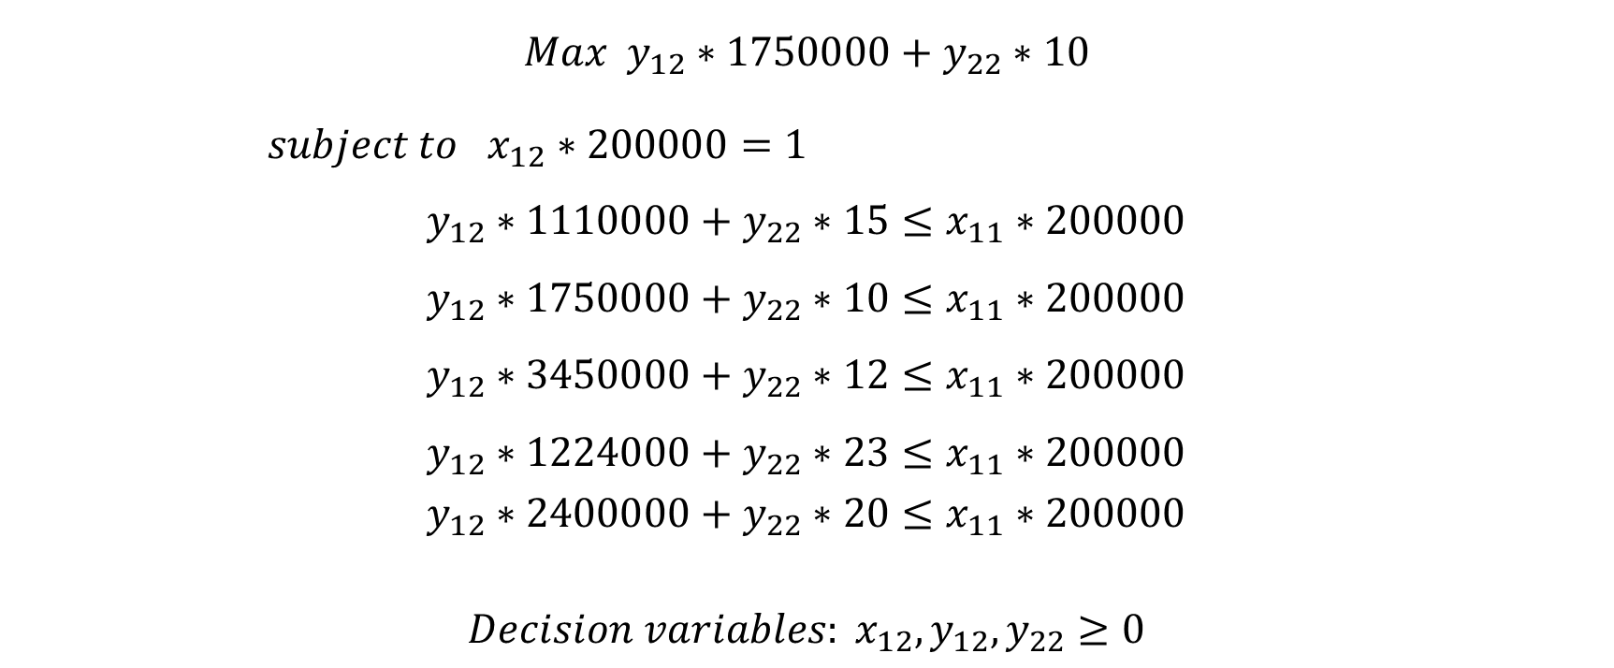
DEA – LP: Two output case – Sales office 2
$$Max y_{12}∗1750000+y_{22}∗10$$
$subject to x_{12}∗200000=1$
$$y_{12}∗1110000+y_{22}∗15≤x_{11}∗200000$$
$$y_{12}∗1750000+y_{22}∗10≤x_{11}∗200000$$
$$y_{12}∗3450000+y_{22}∗12≤x_{11}∗200000$$
$$y_{12}∗1224000+y_{22}∗23≤x_{11}∗200000$$
$$y_{12}∗2400000+y_{22}∗20≤x_{11}∗200000$$
$$Decision variables: x_{12},y_{12},y_{22}≥0$$

Slide 36
DEA – LP: Two output case
Similarly, LP can be formulated for each of the sale office.
If the objective function for the LP of a particular sales office is 1, then the sales office is efficient. Else, it is not.
The results should match our graphical output (even that graphical output is DEA).
See Excel sheet for the solutions.

Slide 37
DEA – LP: Two output case
Graphical method had…

Slide 38
DEA: LP – a Generic formulation
Let us consider a case of multiple inputs and multiple outputs.
For our comparison of the performance of the various sales offices, let us consider the full data.
 | Inputs |  | Outputs
Sales office | Budget (INR) | Team size | Sales (INR) | No of leads
1 | 3,00,000 | 13 | 11,10,000 | 15
2 | 2,56,000 | 9 | 17,50,000 | 10
3 | 5,00,000 | 7 | 34,50,000 | 12
4 | 3,90,000 | 10 | 12,24,000 | 23
5 | 1,85,000 | 14 | 24,00,000 | 20

Slide 39
DEA: LP – a Generic formulation
Two inputs and two outputs – need to define the variables accordingly.
Difficulty to imagine this on a 2D plot.
Optimization problem for each sales office …
Formulation and solution in Excel…

Slide 40
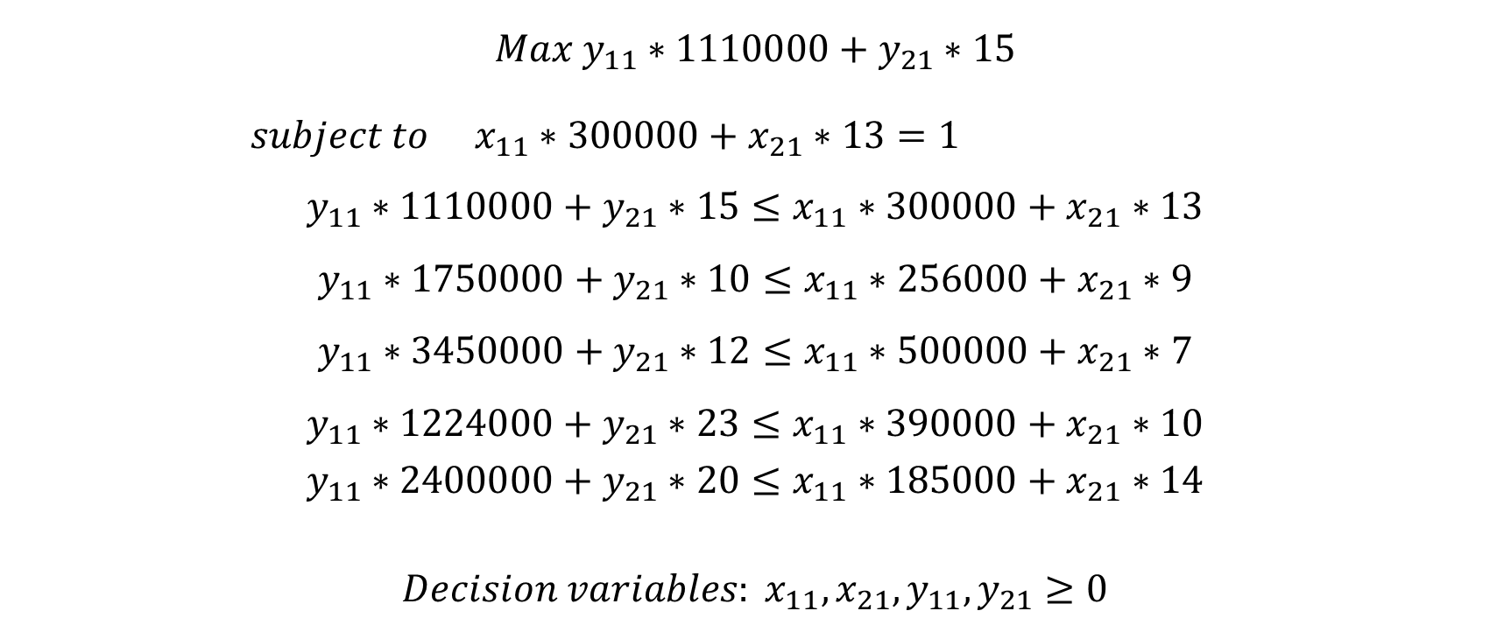
DEA: LP – Sales office 1
$$Max y_{11}∗1110000+y_{21}∗15$$
$subject to x_{11}∗300000+x_{21}∗13=1$
$$y_{11}∗1110000+y_{21}∗15≤x_{11}∗300000+x_{21}∗13$$
$$y_{11}∗1750000+y_{21}∗10≤x_{11}∗256000+x_{21}∗9$$
$$y_{11}∗3450000+y_{21}∗12≤x_{11}∗500000+x_{21}∗7$$
$$y_{11}∗1224000+y_{21}∗23≤x_{11}∗390000+x_{21}∗10$$
$$y_{11}∗2400000+y_{21}∗20≤x_{11}∗185000+x_{21}∗14$$
$$Decision variables: x_{11},x_{21},y_{11},y_{21}≥0$$

Slide 41
Inefficient DMU’s
Identification and prescription

Slide 42
Inefficient DMU’s
The graphical output and the optimization problem solution identifies the efficient and the inefficient DMU’s.
The inefficient DMU’s are NOT on the efficiency frontier.
How can the inefficient DMU’s become efficient?
Of course, by moving towards the efficiency frontier (or the `envelope’).
However, the move to the envelope is neither vertical nor horizontal.
Important economic concepts: the types of efficiencies (“scale” vs “technical”), and disposability of inputs/outputs (“constant” vs “variable” return-to-scale).

Slide 43
Graphical method for inefficient DMU’s
Let us consider the two-input, one-output example again.

Slide 44
Two input example
DMU’s 1 and 4 are inefficient.
These DMU’s need to move towards the frontier.
When they hit the frontier, that point is called “Hypothetical Composite Unit (HCU)”.
For a 2D graph, easy to find the coordinates of the HCU.

Slide 45
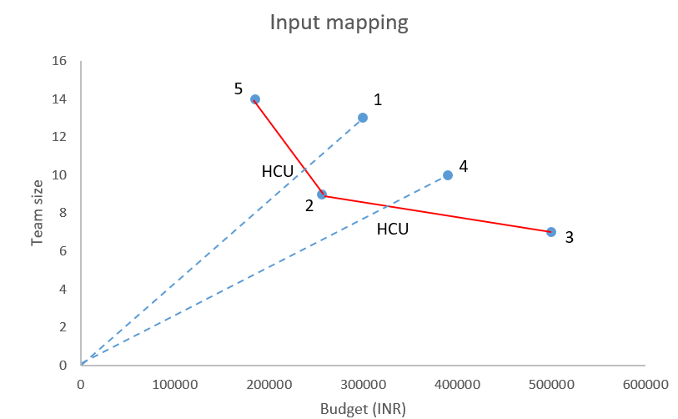
Two input example

Slide 46
Graphical calculation of HCU
Coordinates of DMU 1 are (3,00,000, 13). To generate sales of INR 10,00,000, it uses a budget of INR 3,00,000 and a team size of 13.
The HCU is created as a combination of two efficient units as reference.
For inefficient DMU 1, DMUs 2 and 5 are the reference.
The HCU for 1 is found as a combination of 2 and 5.
From simple geometry, we can find the HCU for 1 to be (2,37,540, 10.3).
Conclusion: For the DMU 1 to be called efficient, it needs to reduce its input: from the current budget of INR 3,00,000 it needs to spend only INR 2,37,540; and reduce the team size from 13 to 10.3.

Slide 47
Analytical calculation of HCU
From the solution of the optimization problem for DMU 1, we find that the efficiency is 0.792 (inefficient!).
From the sensitivity report in Excel, we find that only two Dual variables are non-zero (“shadow prices”). Those variables correspond to the constraints for DMU 2 and 5. Hence, we conclude that these are the reference units for DMU 1.
The dual variable values are 0.74 and 0.26.

Slide 48
Analytical calculation of HCU for DMU 1
 | Reference units |  | HCU for 1 | Actual values | Excess inputs used
 | 2 (2,56,000,9) | 5 (1,85,000, 14)
Dual variable | 0.74 | 0.26
Sales | 10,00,000*0.74 + 10,00,000*0.26 |  | 10,00,000 | 10,00,000 | -
Budget | 2,56,000*0.74 + 1,85,000*0.26 |  | 2,37,540 | 3,00,000 | 62,460
Team size | 9*0.74 + 14*0.26 |  | 10.3 | 13 | 2.7

Slide 49
Analytical calculation of HCU for DMU 4
 | Reference units |  | HCU for 1 | Actual values | Excess inputs used
 | 2 (2,56,000,9) | 3 (5,00,000, 7)
Dual variable | 0.705 | 0.295
Sales | 10,00,000*0.705 + 10,00,000*0.295 |  | 10,00,000 | 10,00,000 | -
Budget | 2,56,000*0.705 + 5,00,000*0.295 |  | 3,27,980 | 3,90,000 | 62,020
Team size | 9*0.705 + 7*0.295 |  | 8.41 | 10 | 1.6

Slide 50
Inefficient DMU’s
Let us consider the two-output, one-input example.

Slide 51
Two-output example
DMU’s 1 and 2 are inefficient.
These DMU’s need to move towards the frontier.
When they hit the frontier, that point is called “Hypothetical Composite Unit (HCU)”.
For a 2D graph, easy to find the coordinates of the HCU.

Slide 52
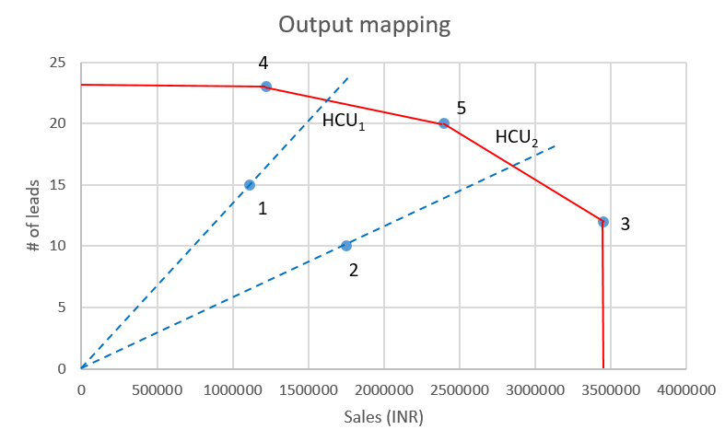
Two-output example

Slide 53
Graphical calculation of HCU
Coordinates of DMU 1 are (11,10,000, 15). With a budget of INR 2,00,000, the DMU 1 generates a sales of INR 11,10,000 and number of sales leads of 15.
The HCU is created as a combination of two efficient units as reference.
For inefficient DMU 1, DMUs 4 and 5 are the reference.
From simple geometry, we can find the HCU for 1 to be (16,26,000, 21.97).
Conclusion: For the DMU 1 to be called efficient, it needs to increase its output: current sales of INR 11,10,000 needs to be increased to INR 16,26,000; and number of sales leads needs to go up from 15 to 21.97.

Slide 54
Analytical calculation of HCU
From the solution of the optimization problem for DMU 1, we find that the efficiency is 0.682 (inefficient!).
From the sensitivity report in Excel, we find that the dual variable values are 0.449 and 0.233, and these are from DMU 4 and 5, respectively.
However, the dual variables don’t add up to 1! (as they did in case of two-input example.)
To achieve that, we divide the shadow prices with the efficiency value and get the final weights to be 0.658 and 0.342 for the reference DMU’s 4 and 5 respectively.

Slide 55
Analytical calculation of HCU for DMU 1
 | Reference units |  | HCU for 1 | Actual values | Need to increase output by
 | 4 (12,24,000,23) | 5 (24,00,000, 20)
Dual variable | 0.658 | 0.342
Budget | 2,00,000*0.658 + 2,00,000*0.658 |  | 2,00,000 | 2,00,000 | -
Sales | 12,24,000*0.658 + 24,00,000*0.658 |  | 16,26,094 | 11,10,000 | 5,16,094
# of leads | 23*0.658 + 20*0.26 |  | 21.97 | 15 | 6.97

Slide 56
Analytical calculation of HCU for DMU 2
 | Reference units |  | HCU for 1 | Actual values | Need to increase output by
 | 3 (34,50,000,12) | 5 (24,00,000, 20)
Dual variable | 0.449 | 0.551
Budget | 2,00,000*0.449 + 2,00,000*0.551 |  | 2,00,000 | 2,00,000 | -
Sales | 34,50,000*0.449 + 24,00,000*0.551 |  | 28,71,450 | 17,50,000 | 11,21,429
# of leads | 12*0.449 + 20*0.551 |  | 16.4 | 10 | 16.4

